Slide 2
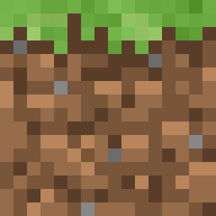

Slide 3
x0, y1
x1, y1
x0, y1
x1, y1
x0, y0
x1, y0
x0, y0
x1, y0

Slide 4
x0, y1
x1, y1
x0, y1
x1, y1
x0 = x - 0.3f;
y0 = y - 0.9f;
x1 = x + 0.3f;
y1 = y + 0.9f;
x0 = x + 0;
y0 = y + 0;
x1 = x + 1;
y1 = y + 1;
x0, y0
x1, y0
x0, y0
x1, y0

Slide 6
PlayerPosX + PlayerSizeX / 2

Slide 7
BlockPosX - BlockSizeX / 2

Slide 8
if(PlayerPosX + PlayerSizeX / 2 > BlockPosX – BlockSizeX / 2) {
}

Slide 9
PlayerPosY - PlayerSizeY / 2

Slide 10
BlockPosY + BlockSizeY / 2

Slide 11
if(PlayerPosX + PlayerSizeX / 2 > BlockPosX – BlockSizeX / 2 &&
PlayerPosY - PlayerSizeY / 2 < BlockPosY + BlockSizeY / 2) {
}

Slide 12
PlayerPosY + PlayerSizeY / 2

Slide 13
BlockPosY - BlockSizeY / 2

Slide 14
if(PlayerPosX + PlayerSizeX / 2 > BlockPosX – BlockSizeX / 2 &&
PlayerPosY - PlayerSizeY / 2 < BlockPosY + BlockSizeY / 2 &&
PlayerPosY + PlayerSizeY / 2 > BlockPosY - BlockSizeY / 2) {
}

Slide 16


